Slide 1
Analisa Basis Data Website Penyewaan Mobil docar.co.id

Slide 2
Anggota:
05
14
25
27
Aril Ibbet Ardana Putra (2341720095)
Keisya Nisrina Aulia (2341720146)
Rizqi Bagus A.(2341720238)
Tionusa Catur Pamungkas (2341720093)

Slide 3
Tentang DOcar
DOcar adalah e-marketplace yang bekerja sama dengan rental-rental mobil di Indonesia untuk menawarkan jasa rental mobil online kepada calon pelanggan. DOcar mempertemukan partner-partner penyedia jasa rental mobil yang ingin memasarkan jasa mobil dan calon penyewa mobil yang ingin mendapatkan mobil sesuai pilihan.

Slide 4
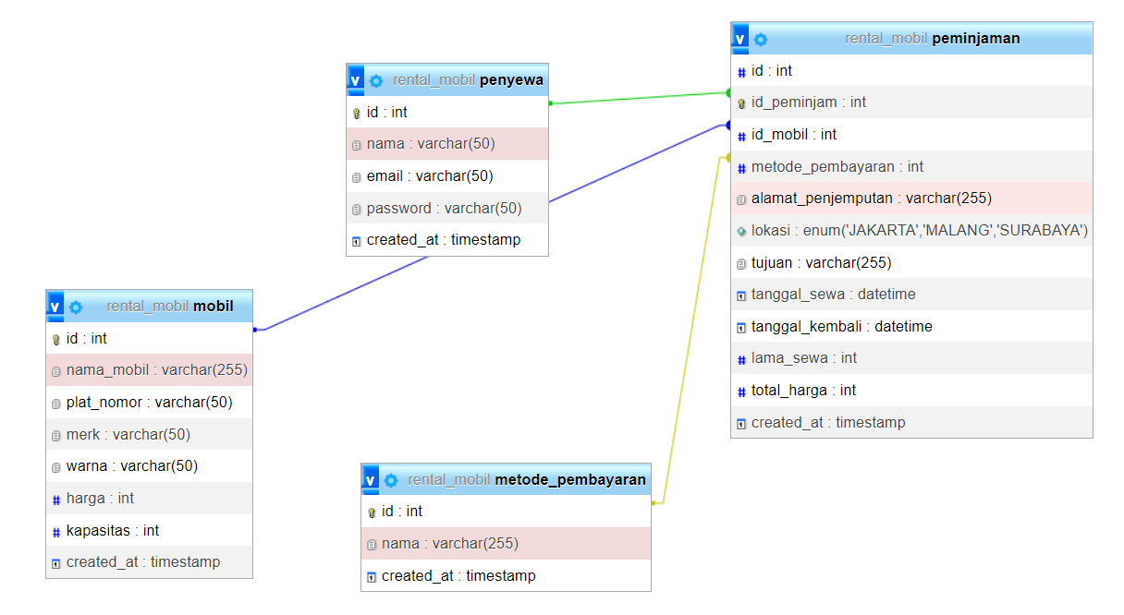
PBL arises from the need to banish lectures that prioritize theoretical content to give way to a new methodology focused on the student
This teaching-learning process starts with a practical problem applicable to reality that the student must solve with the help of the group, thus developing social skills of interaction in small groups, encouraging critical thinking and meaningful learning
Relasi Tabel Basis Data
Primary Keys
Foreign Keys

Slide 5
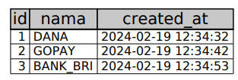


Isi Tabel
metode_pembayaran
penyewa
mobil
peminjaman

Slide 6

Thanks
Please keep this slide for attribution

